Slide 1
Today (Start at :05)
More setup and environment (hopefully last big chunk):
Pulls – remote/origin.
Environments.
Installing stuff in Python (conda, pip, magic commands, and you!)
Basics of stats:
Single variable descriptive statistics.
What this looks like in Python:
Load some data and do some stuff to it!
Actual programing! Yay!

Slide 2
Basic Descriptive Stats

Slide 3
Stats! Stats! Stats! Stats! Stats!
The primary things that statistics gives us is a langue to describe data.
Descriptive statistics.
There are a few basic statistics that we’ve likely seen/used before.
These statistics allow us to describe one variable (feature) of data at a time.

Slide 4
Range
Minimum – smallest value.
Maximum – largest value.
Range – distance between the minimum and the maximum values.
Count (N) – number of records in dataset.

Slide 5
Average(s) – Measures of Central Tendency
We have 3 measures of average:
Mean – Add all values and divide by N.
Median – The value with 50% of other values above, and %50 below.
Mode – The most frequently occurring value.
“Average” normally means the mean, but we should be specific.
Median is very common is scenarios where there are outliers.
Why?

Slide 6
Measures of Dispersion
Measures of dispersion tell us how “spread out” the values are?
Are values tightly clustered or scattered over a wide area?
Variance – a measure of how “varied” the values are, i.e. are they clustered over a small range or distributed broadly.
Standard Deviation – the square root of variance. More commonly used for most analysis.

Slide 7
Single Variable Statistics
These simple stats help us describe data that we are dealing with.
When we look at distributions soon, knowing a distribution pattern and these basic statistics can allow us to describe our data very accurately with a small amount of info.
These are fundamental building blocks, we should be comfortable with each and what it means.
Note: each of these stats looks at one variable at a time, we haven’t looked at all at the relationships between them.

Slide 8
Values In a Dataset
Each of these values is a certain type of value.
Some values are descriptors, like name or hair color.
Some values are measurements, like height or bank account balance.
We can break datatypes into a few divisions…

Slide 9
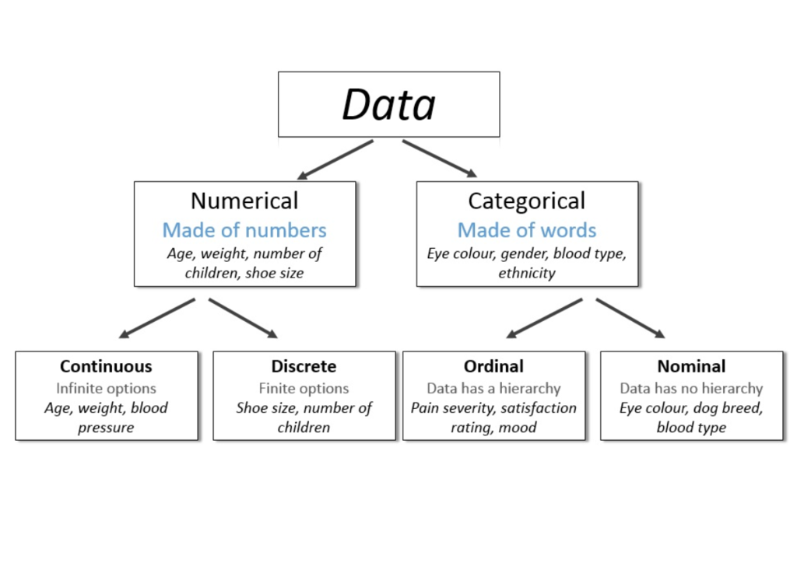

Slide 10
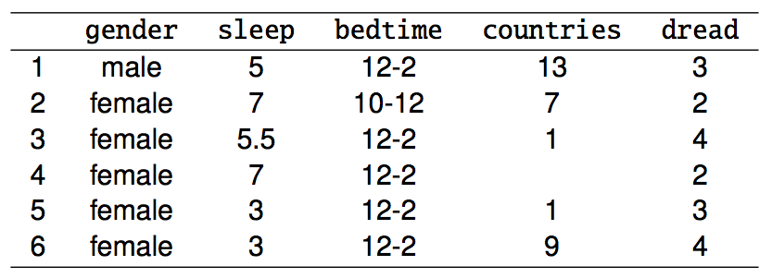
Variable Types
gender: categorical
sleep: numerical, continuous
bedtime: categorical, ordinal
countries: numerical, discrete
dread: categorical, ordinal - could also be used as numerical

Slide 11
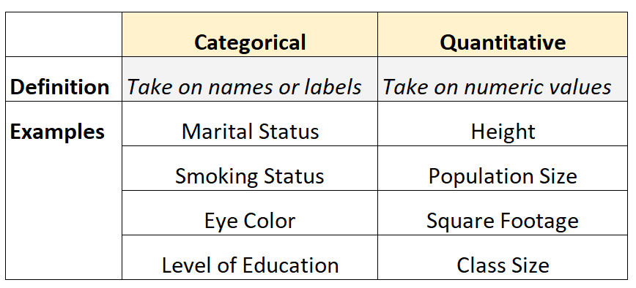

Slide 12
Data Types
The split between numerical and categorical is critical.
Predicting categorical vs numerical values when we get to ML is different.
How we analyze and process categorical vs numerical values is different.
We generally group things by categorical variables.
E.g. group all students who took IB courses in HS when looking at earnings.
We generally calculate things for numerical variables.
E.g. calculate the median of income for the IB group, compared to others.

Slide 13
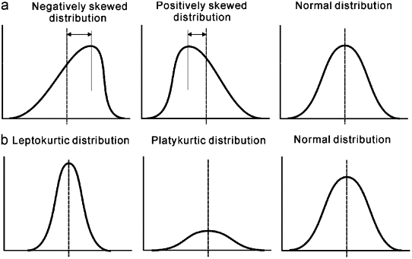
Distributions
These individual statistics are helping to build us up to looking at the distribution – a visual representation of the “shape” of the data’s distribution.

Slide 14

Stats in Python

Slide 15
Using Python for Stats
Python includes several packages that make it easy and quick for us to do stats stuff.
In general, we need to know what we want to do, and python will do all the actual work for us.
Little to no hands on calculating of anything.
The work we do here can flow directly into the machine learning stuff you’ll do later on.

Slide 16
Data in Python
Stats is all about data, so we first need to get data into Python.
In programming, data is stored in something called a data structure.
Data structures are ‘containers’ for data.
Each data structure facilitates different ways to store, access, and manipulate data.
Different structures are good for different things.
Python has lots of data structures, and they can get confusing.
Make sure you pay attention to this part in the programming course!!!

Slide 17
Data Structures
In the programming class you’ll learn details on Data Structures.
Data structures are variables that hold data.
We will usually use a dataframe as a data structure.
Dataframes are part of a package called Pandas.
A dataframe is effectively a 2D table of data that looks exactly like a spreadsheet.
When we load a dataset we load it into a dataframe, then manipulate that df.
Each column is one variable that we have info for, each row is an instance.
There are lots of other data structures, some of which we’ll use.
Lists, series, dictionaries, tuples, etc…
Each one holds data in a different “shape”, and is useful in different scenarios.

Slide 18
Population and Samples
In statistics, the Population is every instance of that item.
E.g. All people who attend NAIT.
A sample is a subset of the population.
E.g. People who responded to a school wide survey.
We usually have a sample of data.
Think: how does what is in the sample impact our calculations?

Slide 19
More Basics
A survey was conducted on students in an introductory statistics course. Below are a few of the questions on the survey, and the corresponding variables the data from the responses were stored in:
gender: What is your gender?
intro_extra: What is your gender?
sleep: How many hours do you sleep at night, on average?
bedtime: What time do you usually go to bed?
countries: How many countries have you visited?
dread: On a scale of 1-5, how much do you dread being here?

Slide 20
Data Format
We generally deal with 2D tables of data, often called a datasheet.
Each row is an example, or instance, of a thing.
Each column is an attribute, or variable, describing that thing.

Slide 21
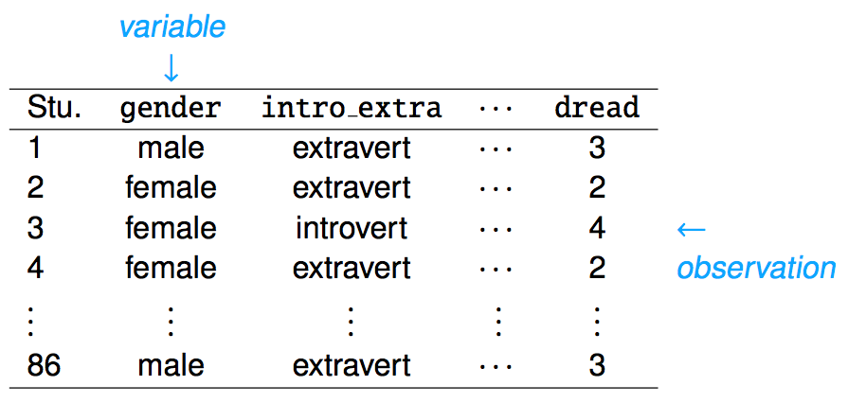

Slide 22

Ok, Time to Program…

